Slide 1
6. Optimization – NP hard models
Laura Hervert Escobar

Slide 2
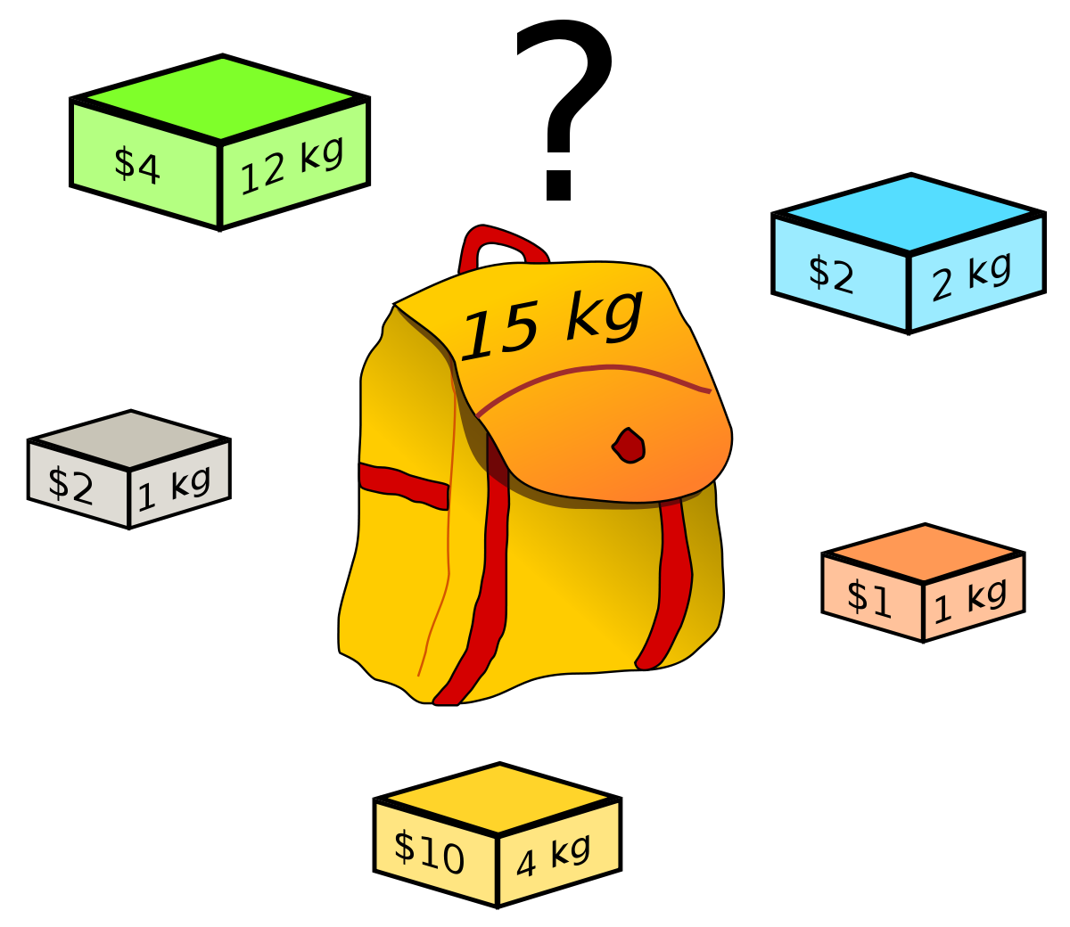
Knapsack problem
Given a set of items, each with a weight and a value, determine the number of each item to include in a collection so that the total weight is less than or equal to a given limit and the total value is as large as possible.
It derives its name from the problem faced by someone who is constrained by a fixed-size knapsack and must fill it with the most valuable items.
The problem often arises in resource allocation where the decision makers have to choose from a set of non-divisible projects or tasks under a fixed budget or time constraint, respectively.

Slide 3
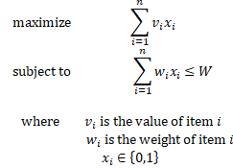
Problem formulation (linear approach)

Slide 4

Ejemplo
An owner has a freighter with a capacity of up to 700 tons. The freighter carries containers of different weights for a given route. On the current route the freighter can transport some of the following containers:
The owner wants to determine the shipment (set of containers) that maximizes the cargo transported.

Slide 5

EXAMPLE
Objective Function: It consists of maximizing the load that the freighter will transport.
Restrictions: The weight of the transported cargo cannot exceed the maximum capacity of the freighter.

Slide 6
Quadratic Knapsack Problem (QKP)
Given a set of items, each with a weight, a value, and an extra profit that can be earned if two items are selected, determine the number of item to include in a collection without exceeding capacity of the knapsack, so as to maximize the overall profit.
Usually, quadratic knapsack problems come with a restriction on the number of copies of each kind of item: either 0, or 1. This special type of QKP forms the 0-1 quadratic knapsack problem, which was first discussed by Gallo et al.^{[2]}
The 0-1 quadratic knapsack problem is a variation of knapsack problems, combining the features of unbounded knapsack problem, 0-1 knapsack problem and quadratic knapsack problem.

Slide 7
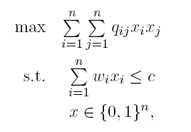
Problem formulation

